Slide 1

Solving Signature Security Challenges with CNNs
Writer Identification vs. Signature Verification
Presented by: Tran Huu Dat

Slide 2
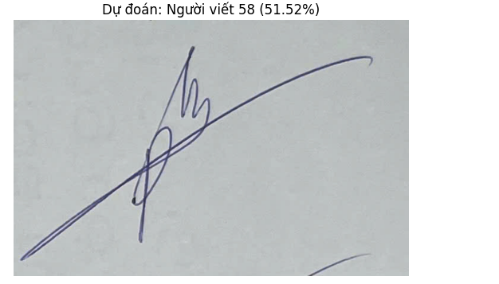
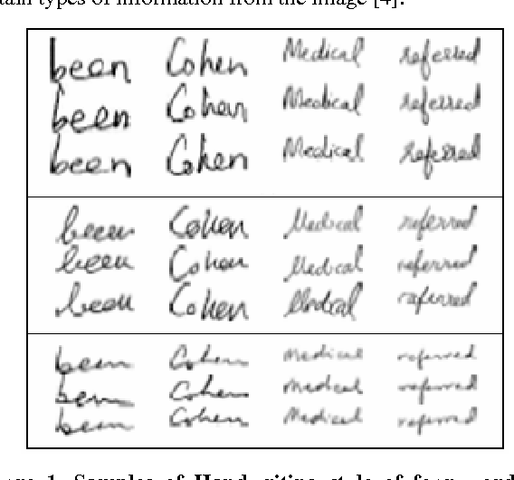
Two Problems, Two Questions
Identification (Classification)
Verification (Metric Learning)
Who is this person?
Are they the same person?

Slide 3




Approach 1: Writer Identification (Classification)
Architecture
Learning Mechanism
Standard CNN (Conv -> Pool -> Dense)
Sparse Categorical Cross Entropy
Pros
Cons
Not scalable (requires retraining for new users), struggles with unseen users.
Straightforward, easy to implement.

Slide 4
Architecture Explained
Standard CNN (Conv -> Pool -> Dense)
Convolutional (Conv) layers act as feature detectors, automatically learning to identify critical patterns like lines, curves, and textures in the signature.
Pooling (Pool) layers reduce the data's spatial dimensions, making the model more efficient and robust to small variations in the signature's position.
The final Dense layers synthesize all the learned features to make the final classification decision: identifying the writer's ID.

Slide 5
Learning Mechanism Explained
Sparse Categorical Cross Entropy
This is a loss function specifically designed for multi-class classification problems where the labels are single integers.
It measures the difference between the model's predicted probability distribution and the actual writer's ID. The training process aims to minimize this error.

Slide 6
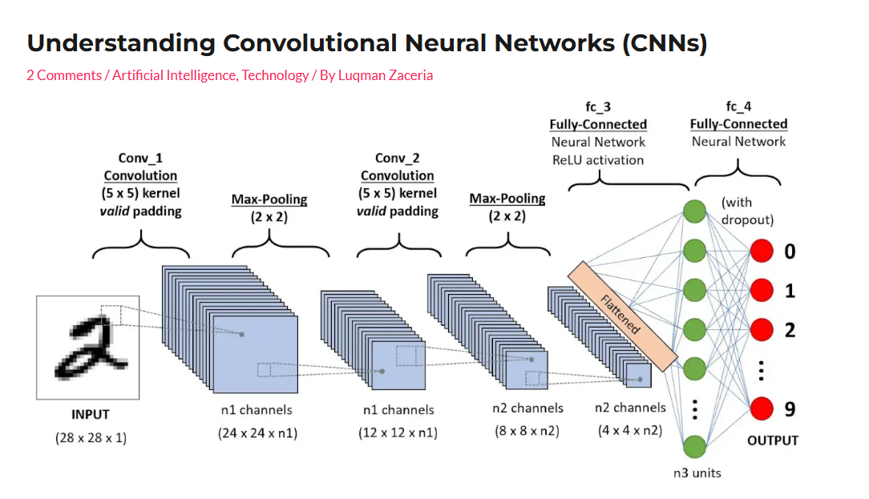
Approach 1: Writer Identification (Classification)
Source: https://lumos.blog/understanding-convolutional-neural-networks-cnns/

Slide 7
Step 1: Feature Extraction (Conv + Pool)
This initial stage is the core of the CNN. The network scans
the image multiple times to build a rich map of increasingly complex features.
Source: https://lumos.blog/understanding-convolutional-neural-networks-cnns/

Slide 8
Step 2: Classification (Flatten + Dense)
After feature extraction, the 2D feature map is "flattened" into a 1D vector.
The Fully-Connected layers then analyze this vector to make the final prediction.
Source: https://lumos.blog/understanding-convolutional-neural-networks-cnns/

Slide 9
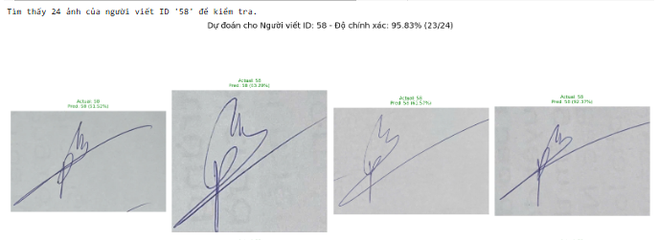
LIVE DEMO - WRITER IDENTIFICATION
Link demo: (25-10-2025) SIGNATURES.ipynb

Slide 10
Approach 2: Signature Verification (Metric Learning)
Architecture
1
Siamese Network (Shared Weights)
Learning Mechanism
2
Triplet Loss / Contrastive Loss
Pros: Scalable
3
(no retraining for new users), more robust.
4
Cons:
More complex to implement, training can be tricky.

Slide 11
Architecture Explained: Siamese Network
Two identical CNN "towers" with Shared Weights.
Siamese" means twin. This architecture uses two identical CNN networks that, crucially, share the exact same weights.
This ensures that both input images are processed and mapped into the feature space in the exact same way, creating a fair basis for comparison.

Slide 12
Learning Mechanism Explained: Triplet Loss
Anchor - Positive - Negative
The model learns by comparing three images simultaneously: an Anchor (the base signature), a Positive (another signature from the same person), and a Negative (a signature from a different person).
The goal of the loss function is to "pull" the Anchor and Positive closer together while "pushing" the Anchor and Negative further apart in the feature space.

Slide 13
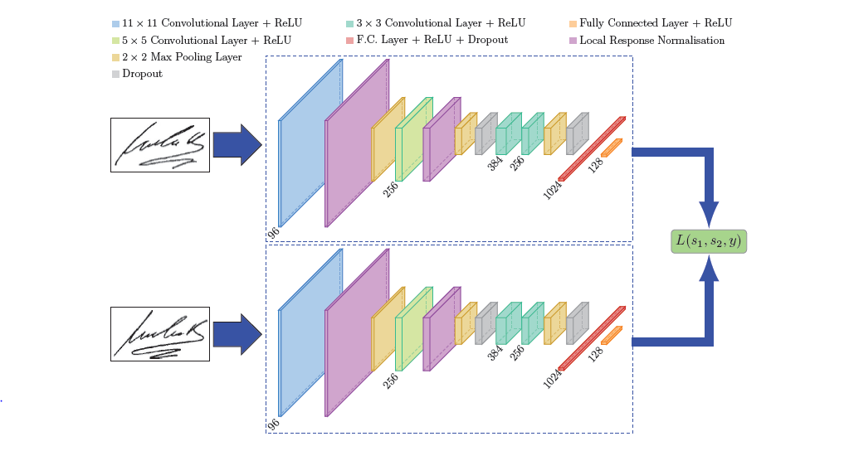
Approach 2: Signature Verification (Metric Learning)
Source: https://tiensu.github.io/blog/55_siamese_network/

Slide 14
Approach 2: Signature Verification (Metric Learning)
The two signature images
are passed through the parallel, identical CNN towers to generate two "feature vectors," which represent the essence of each signature.
Source: https://tiensu.github.io/blog/55_siamese_network/

Slide 15
Approach 2: Signature Verification (Metric Learning)
Instead of classifying, the model calculates the "distance" or similarity between the two feature vectors. The training process optimizes the network's weights so this distance accurately reflects the real-world relationship
(same or different writer).
Source: https://tiensu.github.io/blog/55_siamese_network/

Slide 16
Comparing the Two Approaches
Feature | Identification (My Demo) | Verification (Siamese)
Goal | Classify among known users | Match a pair of signatures
Scalability | Poor (requires retraining) | Excellent
Use Case | Forensic analysis (closed set) | Banking, Access Control (open set)
Complexity | Simpler | More Complex

Slide 17



Conclusion
Main Takeaway
The choice of CNN architecture depends critically on the specific problem definition.
Summary
Classification (Identification) is powerful but limited, while Metric Learning (Verification) offers scalability and flexibility for real-world systems.

